Slide 1
Unit 1: Foundations of Government
Day 1 Essential Question:
Why should you study government?

Slide 2
Why should you study government?

Slide 3
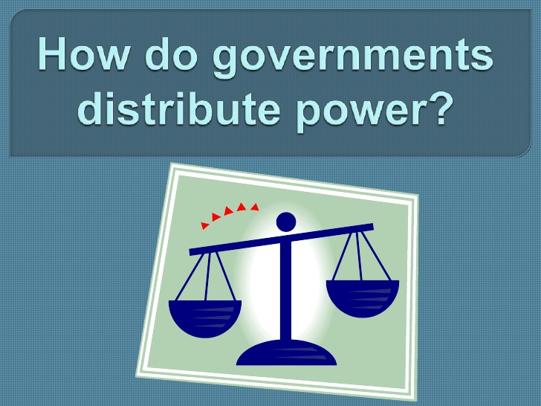
Concept 1: Distribution of Power

Slide 4
The Four Features of a State
Four Features
Population
Government
Territory
Sovereignty

Slide 5
Population
People share similar general beliefs
Sharing these basic beliefs equates into a more stable gov’t
Shifts in population changes the power matrix

Slide 6
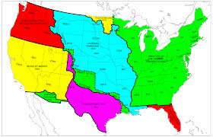
Territory
Area of fixed boundaries
Things that change fixed boundaries:
- war
- negotiations
- land purchase

Slide 7
Sovereignty
The key characteristic of a state is sovereignty.
The state has supreme and absolute authority in its boundaries.
It has complete independence and powers to make laws and foreign policy and determine its course of action.
In theory, no state has the right to interfere with the internal affairs of another state.

Slide 8
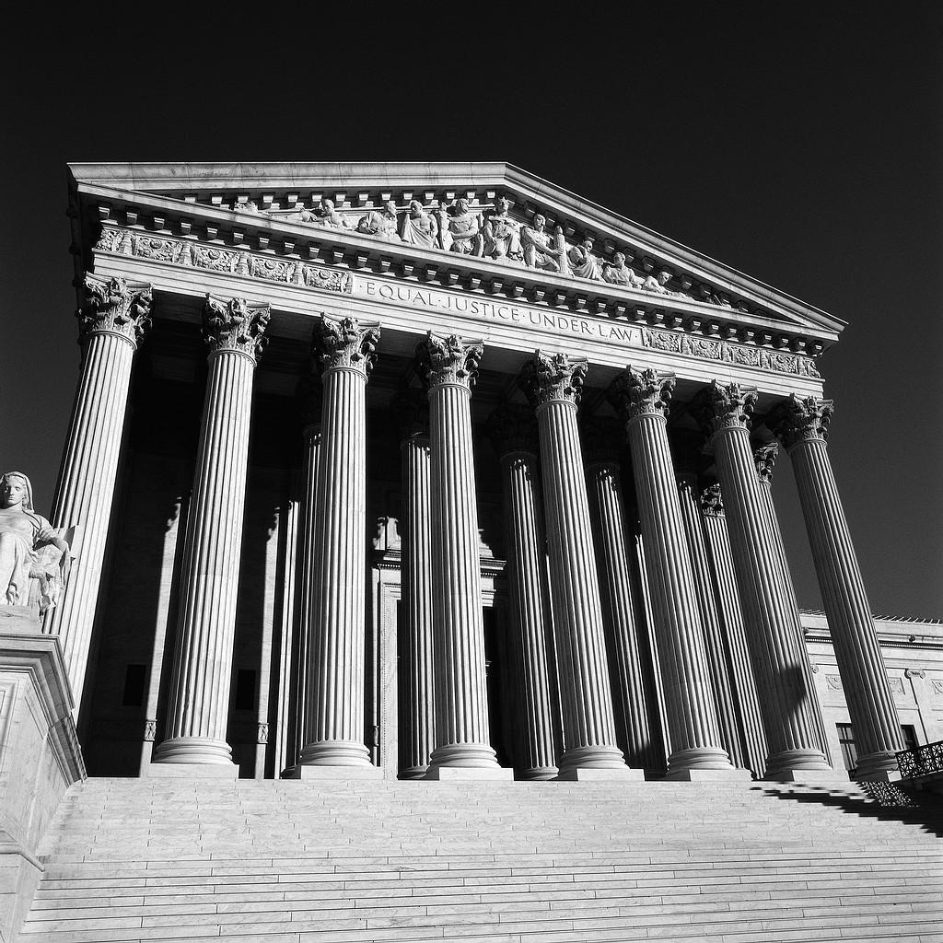
Government
The institution through which the state is able to perform all of its essential functions.

Slide 9
Unit 1: Foundations of Government
Day 2 Essential Question:
What is the purpose of each feature of government?

Slide 10
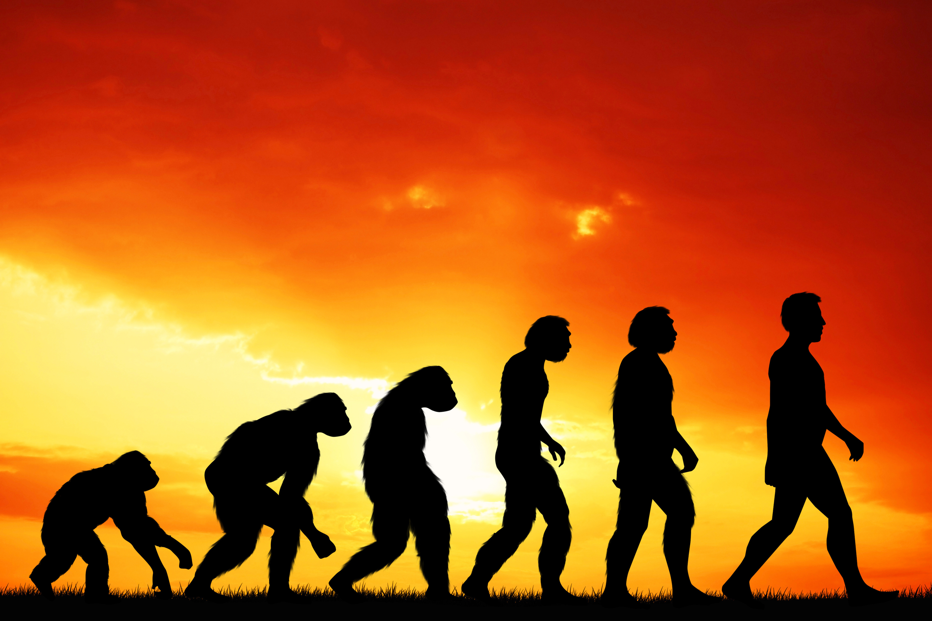
Theories of the Origin of the State
Evolutionary
Began with the family & evolved as the family grew
Notes:
Photo Credit: Evolution of Man

Slide 11
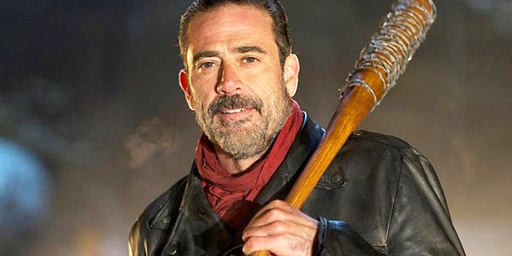
Theories of the Origin of the State
Force
People need each other to survive
People of an area are forced under the authority of one group or person
Those in charge use violence/ threat of violence to get the work accomplished
Notes:
Photo Credit: Jeffrey Dean Morgan as Negan from the Walking Dead TV Series

Slide 12
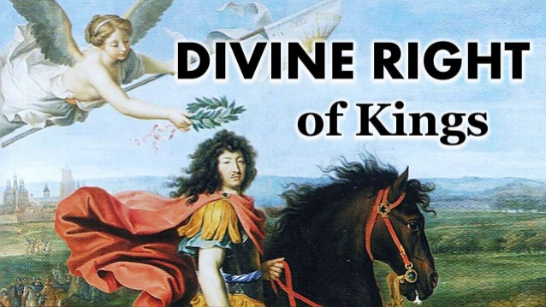
Theories of the Origin of the State
Divine Right
Believed that rulers were descendants of the people’s god(s) OR chosen by the god(s) to rule
Notes:
Photo Credit: Jeffrey Dean Morgan as Negan from the Walking Dead TV Series

Slide 13
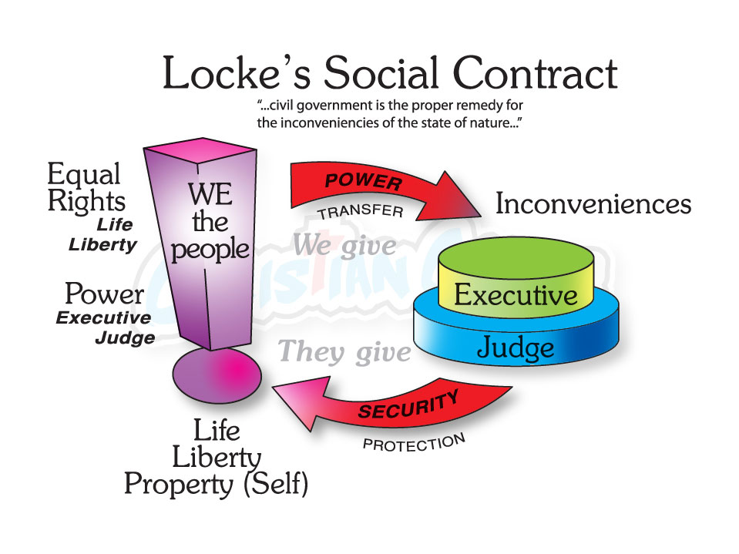
Theories of the Origin of the State
Social Contract
People gave to the state only the power necessary to bring about and maintain order
Notes:
Photo Credit: Jeffrey Dean Morgan as Negan from the Walking Dead TV Series

Slide 14
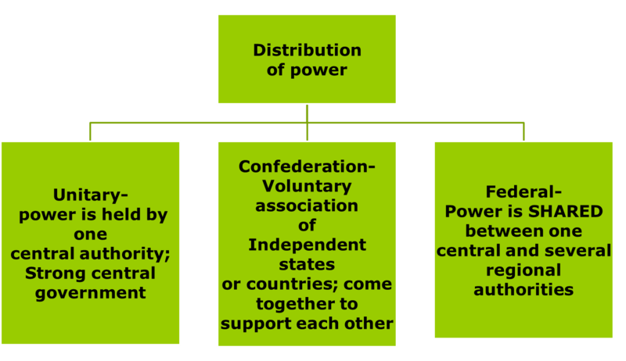
Government Systems
Unitary system- gives all powers to the national or central gov’t

Slide 15
Government Systems
Confederate system- a loose union of independent and sovereign states

Slide 16
Government Systems
Federal system- power is shared between the central or national gov’t & the states or provincial gov’ts

Slide 17
Government Systems- How Power Flows

Slide 18
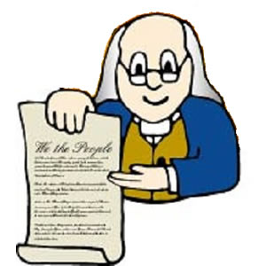
Constitutions & Government
constitution- a plan that provides the rules for government
Provides supreme law for states and their governments

Slide 19
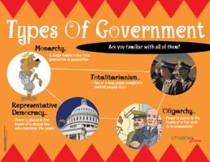
Major Types of Government
Governments can be classified according to who governs the state
Authoritarian
Monarchy
Democracy

Slide 20
Major Types of Government
Authoritarian- few, if any, political freedoms
Dictatorships- power is in the hands of one person
Totalitarian- the government has total control
Oligarchy- a small group of people hold the power

Slide 21
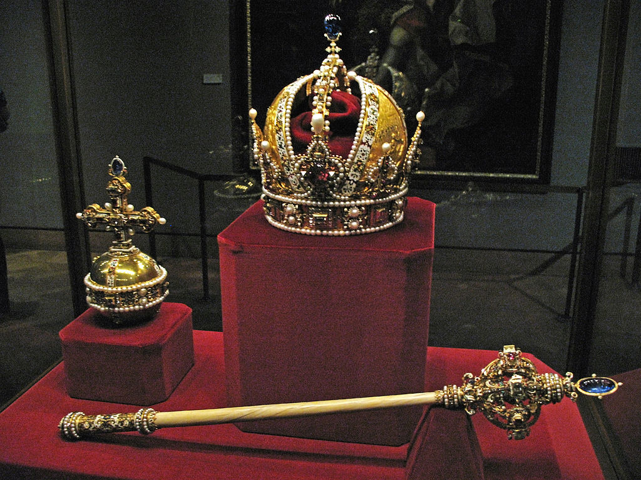
Major Types of Government
Monarchy
Form of government where a king, queen, or emperor rules the people

Slide 22
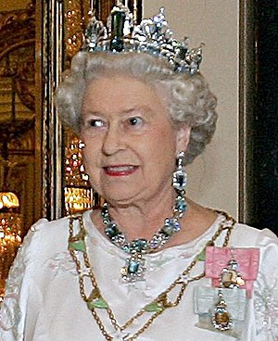
Major Types of Government
Two types of monarchies
Absolute monarchy- the king or queen shares none of the power (Swaziland)
Constitutional monarchy- the king or queen is limited by the law (England)

Slide 23
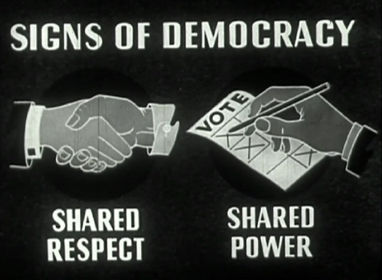
Major Types of Government
Democracy
The people hold the sovereign power of the government
Example- United States

Slide 24
Major Types of Government
Three types of democracy
Direct democracy- people decide (e.g. vote on, form consensus on) policy initiatives directly.
Representative democracy- founded on the principle of elected officials representing a group of people, as opposed to direct democracy.
Republic- supreme power is held by the people and their elected representatives, and which has an elected or nominated president rather than a monarch

Slide 25
Parliamentary vs. Presidential Democracies
Parliamentary
Presidential
The system used in places like the U.K.
The Prime Minister is elected from the legislative branch directly (not the people)
The Parliament can replace a Prime Minister by voting them out and replacing them.
The system used in the U.S.
President is recognized as the head of the government and leads the executive branch.
The president is directly voted on by the people via the Electoral College.

Slide 26
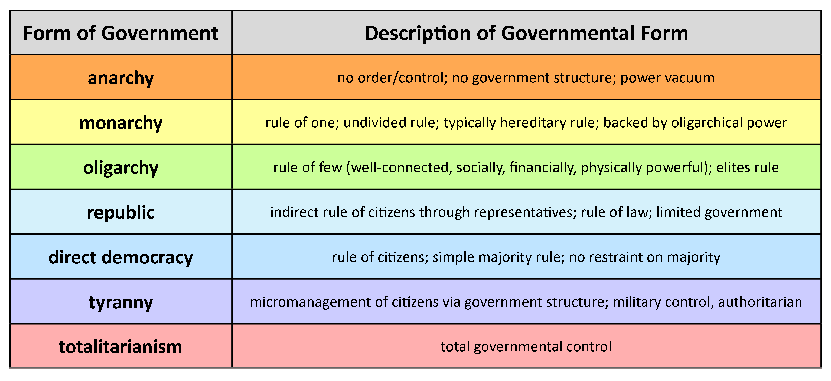
Major Types of Government

Slide 27
Principles of Democracy
Citizen Participation
Regular Free and Fair Elections
Accepting the Results of the Elections
The Rule of Law
Majority Rule with Minority Rights

Slide 28
Principles of Democracy
Accountability
Transparency
Limited Government and a Bill of Rights
Control of the Abuse of Power
Economic Freedom

Slide 29
Principles of Democracy
Equality
Individual or Human Rights
Independent Judiciary
Competing Political Parties

Slide 30
SLC Concept 1 Review Questions
What are the four features of a state?
Which feature of a state believes in sharing similar beliefs in order to establish a more stable government?
What three ways can you expand a given territory? Which has the U.S. used to expand its territory?
What would have to shift in order to change the power matrix of a given territory or country?
Which feature of a state allows the state to perform all of its essential functions?
Which feature of a state is the key characteristic of a state because it ensures it has absolute authority in its boundaries?
What are the four theories of the origin of the state?
Which theory states a person has the right to rule because they are descended from a god or deity of the people?

Slide 31
SLC Concept 1 Review Questions
Which theory says that government began with a nuclear family and grew from there?
Which theory of the origin of a state stipulates that people give the state only the power necessary to maintain order?
Which theory states that people use violence or the threat of violence to get the work accomplished?
What is the difference between a unitary, confederate, and federal system of government?
What do you can a plan for government?
What are the major types of government?
What is the difference between an absolute monarchy and a constitutional monarchy?
What are the three types of democracy? Which does the U.S. use?

Slide 32
SLC Concept 1 Review Questions
Which type of government deals with the rule or control of a country by a small group of people?
When dealing with the election/ selection of an executive leader, how are parliamentary and presidential systems of democracy different?

Slide 33
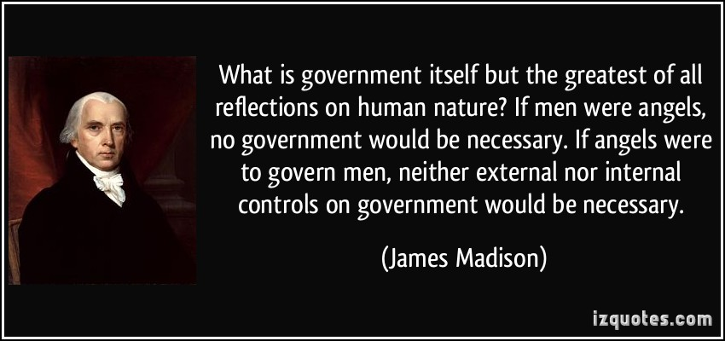
Concept 2: Limited Government & the Rule of Law
EQ: What is government & why do we need it?

Slide 34
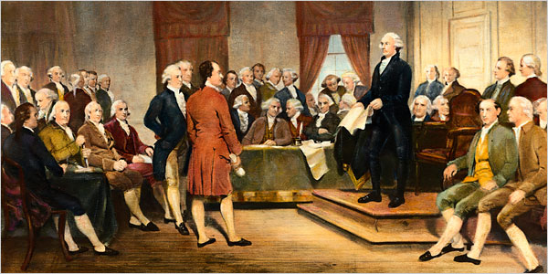
What is government?
An organized system to provide order and protection for a nation’s people

Slide 35
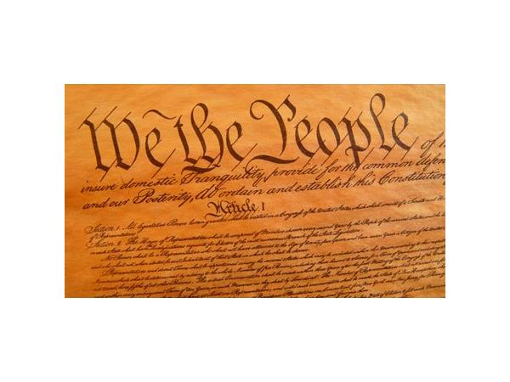
Why do we need government?
If you have not already done so, write down some ideas in your notes about why you think we need government.

Slide 36
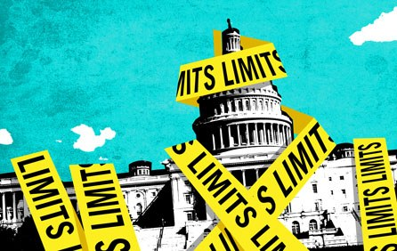
Limited Government
Political system in which powers of the government are restricted; usually by a written constitution

Slide 37
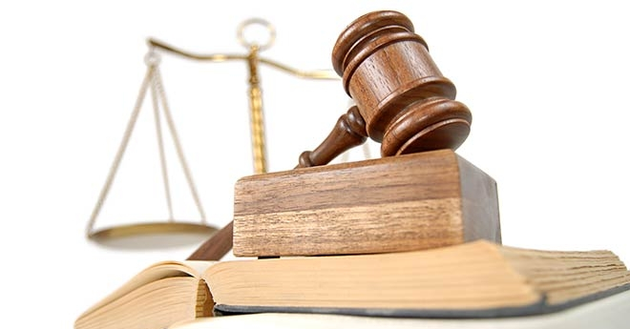
Rule of Law
Government is based on clear and fairly enforced laws and no one is above the laws

Slide 38
The Three English Documents that Helped to Set the Foundation of our Country
1628
Petition of Rights
1 2 3

Slide 39
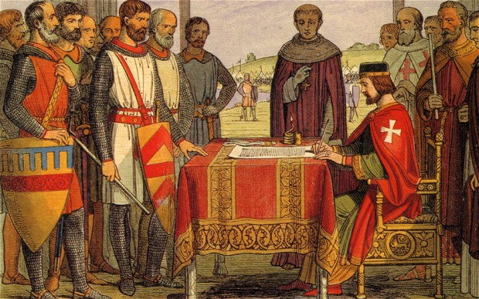
Magna Carta, 1215
Signed by King John of England in 1215
This charter introduced limited government, due process of law, trial by jury, & protection of private property and civil protections.
The Magna Carta established Rule of Law, which meant that all people, even the king, have to obey the laws

Slide 40
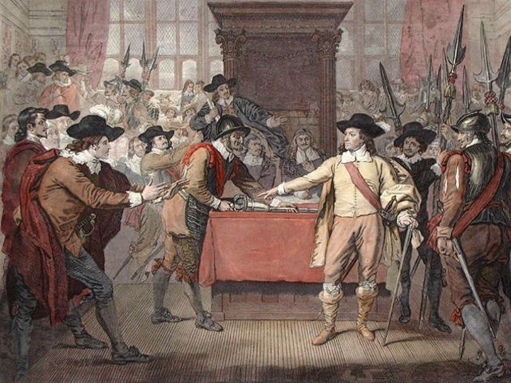
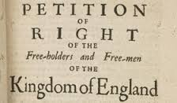
Petition of Rights, 1628
Law passed by English parliament in 1628 to try to limit the power of King Charles I.
Rights provided by the Petition of Rights:
No taxes may be levied without the consent of Parliament
No subject may be imprisoned without cause shown (right of habeas corpus)

Slide 41
Petition of Rights, 1628
Rights provided by the Petition of Rights (cont.):
No soldiers may be quartered upon the citizenry
Martial law may not be used in time of peace

Slide 42
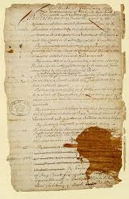
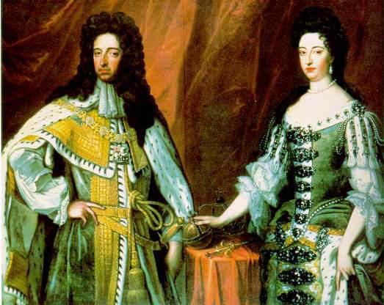
English Bill of Rights, 1689
Passed by Parliament in 1689 after years of conflict and civil war.
Parliament offered the throne to William and Mary of Orange, but insisted they accept the Bill of Rights as a condition of their rule.

Slide 43
English Bill of Rights, 1689
Rights provided by the English Bill of Rights:
No royal interference with the law
No taxation by Royal Prerogative. The agreement of Parliament became necessary for the implementation of any new taxes.

Slide 44
English Bill of Rights, 1689
Rights provided by the English Bill of Rights:
Only civil courts, not church courts, are legal
Freedom to petition the monarch without fear of retribution
No standing army during time of peace without consent of Parliament

Slide 45
English Bill of Rights, 1689
Rights provided by the English Bill of Rights:
No royal interference in the freedom of the people to have arms for their own defense
No royal interference in the election of members of Parliament

Slide 46
English Bill of Rights, 1689
Rights provided by the English Bill of Rights:
Freedom of speech and debates in parliament ought not be impeached or questioned in any court or place out of parliament
Grants and promised fines and forfeitures before conviction are void
No excessive bail or cruel and unusual punishments may be imposed

Slide 47
SLC Concept 2 Review Questions
What is the definition of government?
What do you call a political system in which the powers of government are restricted?
What is meant by the Rule of Law?
What English document introduced limited government and established the Rule of Law?
Which English document was required to be signed by William and Mary of Orange in order for them to rule, and provided the citizens a guaranteed rights and liberties?
Of the three English documents, which one expanded the rights of the Magna Carta to the peasants?

Slide 48
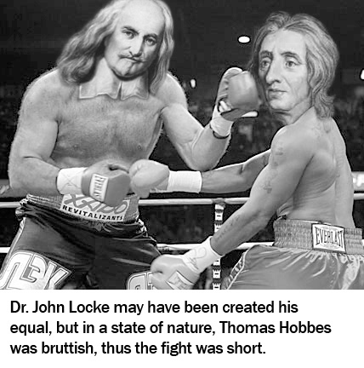
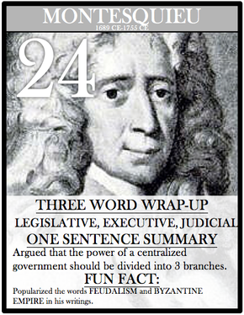
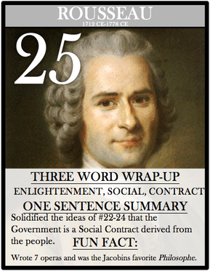
Concept 3: Political Philosophy
EQ: How did political philosophers influence our Founding Fathers in the creation of our government documents?

Slide 49
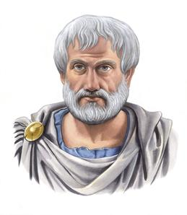
Aristotle
The Beginning of Political Science
One of the first students of government under Plato
Known as the “Father of Political Science”
the study of government
He favored a constitutional government with combined principles of oligarchy and democracy as the ideal form of government.

Slide 50
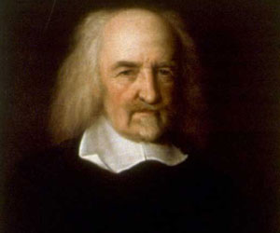
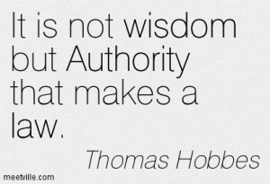
Thomas Hobbes
Writings: Leviathan
Principle or Theory: social contract
What does it mean? People give up freedom in exchange for protection from government

Slide 51
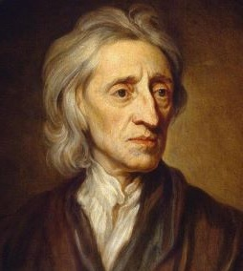
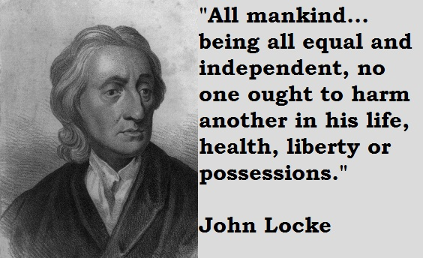
John Locke
Writings: Second Treatise on Government
Principle or Theory: Natural Rights
What does it mean? Everyone has God given rights that cannot be taken away

Slide 52
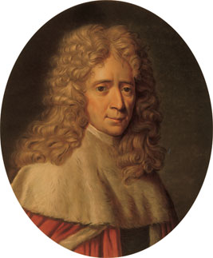
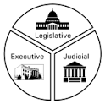
Baron de Montesquieu
Writings: The Spirit of Laws
Principle or Theory: Separation of Powers
What does it mean? Power should be divided into three branches and each has a job that only it can do

Slide 53
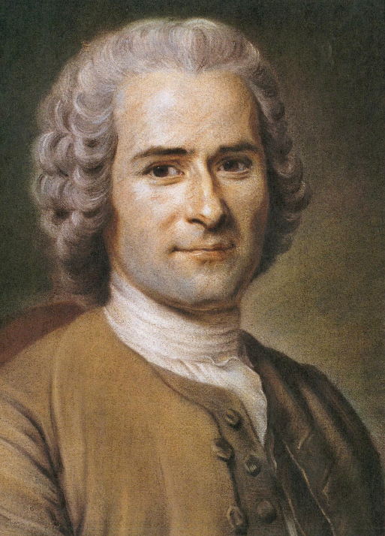
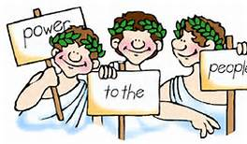
Jean Jacques Rousseau
Writings: The Social Contract
Principle or Theory: popular sovereignty
What does it mean? The government should reflect the will of the people

Slide 54
How did these philosophers influence the Declaration of Independence?
Looking at what each philosopher believed, write down how their beliefs influenced early American documents using the organization chart provided.

Slide 55
Formation
of the
United States
Government

Slide 56
American Revolution
America was originally a British colony
The U.S. won it’s independence and became it’s own country during the American Revolution
The Declaration of Independence was written and approved during the American Revolution to formally announce separation from Great Britain

Slide 57
Declaration
of
Independence

Slide 58
Written by Thomas Jefferson
I will tell you a brief story of how one decision made by Jefferson changed the course of history.
Approved on July 4, 1776
Provides persuasive argument for why Americans want independence from the British king

Slide 59
Articles
of
Confederation

Slide 60
First law of the land of the United States
Went into effect in 1781
Created a loose confederation of states

Slide 61
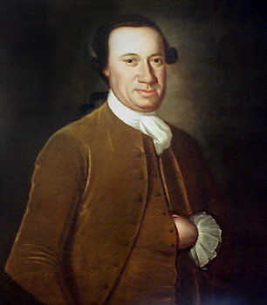
First president of Congress under the Articles
John Hanson

Slide 62
Government Under the Articles
The nation’s first government included a single-chamber Congress, with limited powers.
Each state had one vote, but it had no executive branch or court system.
Executive office of president was more of a “ceremonial position”

Slide 63
Why don’t we still have it?
IT WAS TOO WEAK!!!
No executive branch of government
Congress could not tax, regulate trade between states, or enforce laws

Slide 64
Why don’t we still have it?
IT WAS TOO WEAK!!!
Amending the Articles required approval of all the states.
Shays’ Rebellion showed the government was too weak to handle a crisis and led to a call for a constitutional convention to fix the problem.

Slide 65
SLC Concept 3 Review Questions
Which philosopher was one of the first students of government and is known as the “Father of Political Science”?
Complete the following chart:
What country controlled the American colonies prior to the revolution?
What was the purpose of the Declaration of Independence?
Who wrote the Declaration?
What was the name of the document that was the first law of the land of the U.S.?
Philosopher | Writing | Theory
John Locke
Jean Jacques Rousseau
Baron de Montesquieu
Thomas Hobbes

Slide 66
SLC Concept 3 Review Questions
Who was the first president under the Articles of Confederation?
Describe the government under the Articles.
Why was the Articles considered to be too weak to last?
What conflict demonstrated the weaknesses of the Articles?
What did the Founding Fathers decide to do to address the problems with the Articles?

